Slide 1


Amoon Austin
December 17, 2024

Slide 2

Outline
Executive Summary
Introduction
Methodology
Results
Conclusion
Appendix

Slide 3
Executive Summary
Summary of methodologies
Data Collection with Web Scraping
Data Collection through API
Data Wrangling
Exploratory Data Analysis with Data Visualization
Exploratory Data Analysis with SQL
Interactive Visual Analytics with Folium
Machine Learning Prediction
Summary of all results
Exploratory Data Analysis result
Interactive analytics in screenshots
Predictive Analytics result

Slide 4
Introduction
Project background and context
SpaceX promotes Falcon 9 rocket launches on its website with a price tag of $62 million, while other providers charge over $165 million per launch. The cost savings largely stem from SpaceX’s ability to reuse the first stage. Thus, by predicting whether the first stage will successfully land, we can estimate the cost of the launch. This information could be valuable for other companies looking to compete with SpaceX for rocket launches. The objective of this project is to develop a machine learning model that predicts the successful landing of the first stage.
Problems you want to find answers
What factors influence the success of a rocket landing?
The relationship between different features that contribute to the likelihood of a successful landing.
The operational conditions necessary to ensure a successful landing program.
What are the key characteristics that distinguish a successful landing from a failed one?
How do the interactions between various rocket variables affect the outcome of the landing?
What conditions are required to optimize SpaceX's landing success rate?

Slide 5

Section 1

Slide 6
Methodology
Executive Summary
Data collection methodology:
Data was collected through the SpaceX REST API and web scraping from Wikipedia.
Perform data wrangling
Unnecessary columns were dropped, and one-hot encoding was applied to categorical features for classification models.
Perform exploratory data analysis (EDA) using visualization and SQL
Perform interactive visual analytics using Folium and Plotly Dash
Perform predictive analysis using classification models
Developing, fine-tuning, and evaluating classification models.

Slide 7
Data Collection
Data collection was performed by making a GET request to the SpaceX API, which provided rocket, launch, and payload information.
The API response was decoded as JSON using the .json() function, then converted into a pandas dataframe using .json_normalize().
The data was cleaned by checking for and filling in any missing values.
Additionally, web scraping was conducted from Wikipedia to gather Falcon 9 launch records.
Using BeautifulSoup, the launch data was extracted from an HTML table, parsed, and converted into a pandas dataframe for further analysis.
The SpaceX API URL used was api.spacexdata.com/v4/, and the Wikipedia page URL was:https://en.wikipedia.org/w/index.php?title=List_of_Falcon_9_and_Falcon_Heavy_launches&oldid=1027686922.
SpaceX Rest API Call
API returns JSON file
Clean Data and Export it
Make Dataframe from JSON
Get HTML response from Wikipedia
Extract data with beautifulSoup
Export Data
Make Dataframe

Slide 8
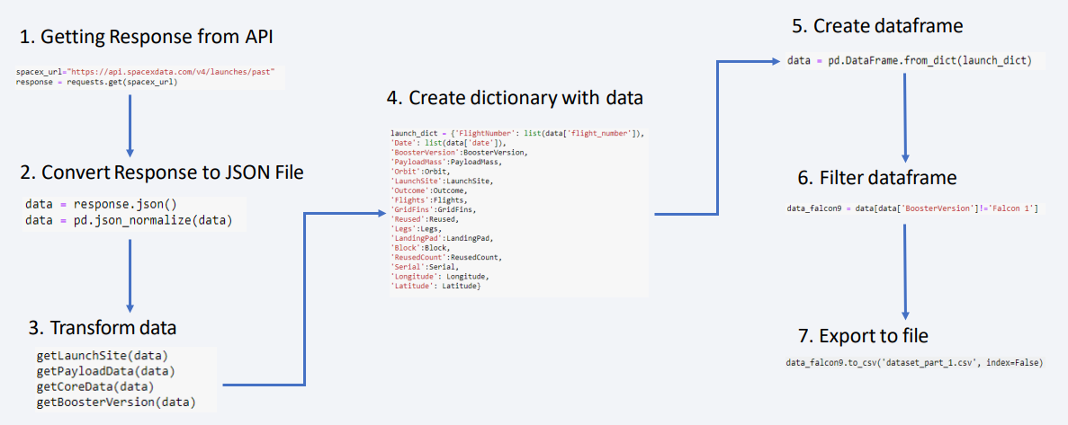
Data Collection – SpaceX API

Slide 9
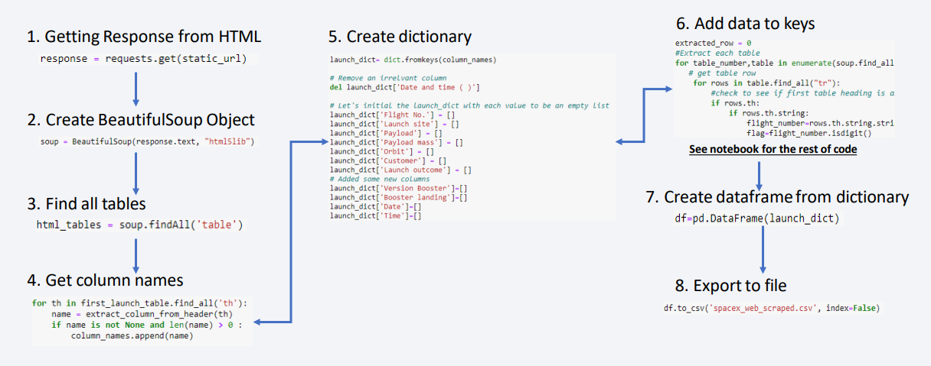
Data Collection - Scraping

Slide 10

Data Wrangling
Exploratory data analysis (EDA) was performed to determine the training labels.
We analyzed the number of launches at each site and the frequency of each orbit.
The landing outcome was derived from the outcome column, where "True Ocean," "True RTLS," and "True ASDS" indicated a successful mission, while "False Ocean," "False RTLS," and "False ASDS" signified failure.
These string variables were transformed into categorical variables, with 1 representing success and 0 representing failure.
The results were then exported to a CSV file.

Slide 11

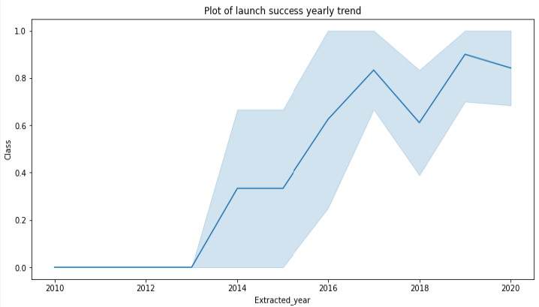
EDA with Data Visualization
We explored the data by visualizing the relationship between flight number and launch site, payload and launch site, success rate of each orbit type, flight number and orbit type, the launch success yearly trend.
Bar Graph (Success rate vs Orbit)
Line Graph (Success rate vs Year)

Slide 12
EDA with SQL
We loaded the SpaceX dataset into a PostgreSQL database directly within the Jupyter notebook and performed exploratory data analysis (EDA) using SQL queries to gain insights. Our SQL queries aimed to:
Display the unique launch sites in the space mission.
Display five records where launch sites begin with 'CCA’.
Display the total payload mass carried by boosters launched by NASA (CRS).
Display the average payload mass carried by booster version F9 v1.1.
List the date of the first successful landing outcome on a ground pad.
List the boosters that succeeded in drone ship landings with payload masses between 4000 and 6000.
List the total number of successful and failed mission outcomes.
List the booster versions that carried the maximum payload mass.
Display records of failure landing outcomes on drone ships in 2015, including month names, booster versions, and launch sites.
Rank the count of successful landing outcomes between April 6, 2010, and March 20, 2017, in descending order.

Slide 13
Build an Interactive Map with Folium
We used Folium to create an interactive map centered on NASA Johnson Space Center in Houston, Texas. The map included various markers and map objects to visualize the launch sites and their success or failure rates. Specifically:
Red circles were placed at NASA Johnson Space Center and at each launch site's coordinates, labeled with their respective names.
Markers were color-coded to indicate landing outcomes: green for successful landings (class 1) and red for unsuccessful landings (class 0).We used marker clusters to group points and display different information for the same coordinates.
We calculated the distances from launch sites to nearby railways, highways, coastlines, and cities, plotting lines to represent these distances.
This mapping approach helped us identify which launch sites had relatively high success rates and understand their proximity to key locations, enhancing our analysis of the data.

Slide 14
Build a Dashboard with Plotly Dash
We built an interactive dashboard using Plotly Dash, which includes several key components for data visualization and user interaction:
A dropdown menu allows users to select a specific launch site or view data for all launch sites.
A pie chart displays the total number of successful and failed launches for the selected site.
A range slider enables users to select a payload mass range.
A scatter plot shows the relationship between the landing outcome (success or failure) and the payload mass (Kg) for different booster versions.
The interactive elements help users explore and analyze the data more effectively.
Link already shared for review.

Slide 15
Predictive Analysis (Classification)
Data Preparation:
Loaded the dataset using numpy and pandas.
Normalized the data.
Split the data into training and test sets.
Model Preparation:
Selected various machine learning algorithms.
Set parameters for each algorithm using GridSearchCV.
Trained GridSearchCV models with the training dataset.
Model Evaluation:
Identified the best hyperparameters for each model.
Computed the accuracy for each model using the test dataset.
Plotted a confusion matrix to visualize model performance.
Model Comparison:
Compared models based on their accuracy.
Chose the model with the best accuracy.

Slide 16
Results
Exploratory data analysis results
Interactive analytics demo in screenshots
Predictive analysis results

Slide 17

Section 2

Slide 18
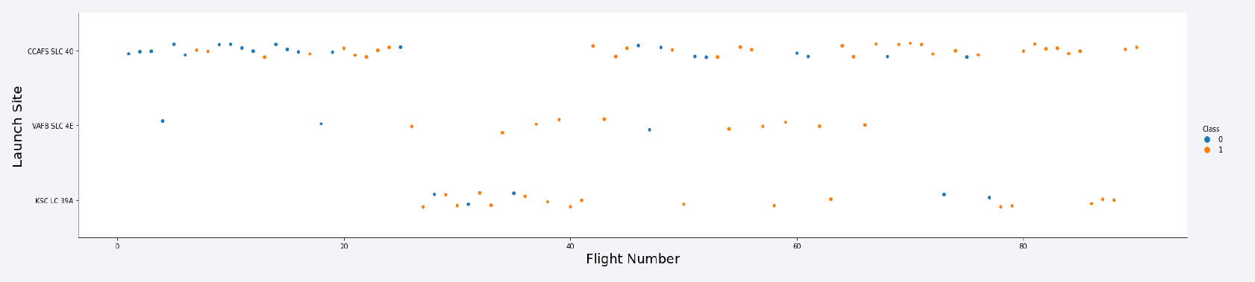
Flight Number vs. Launch Site
From the plots, we observed that the success rate at a launch site increases with the number of flights conducted at that site.

Slide 19
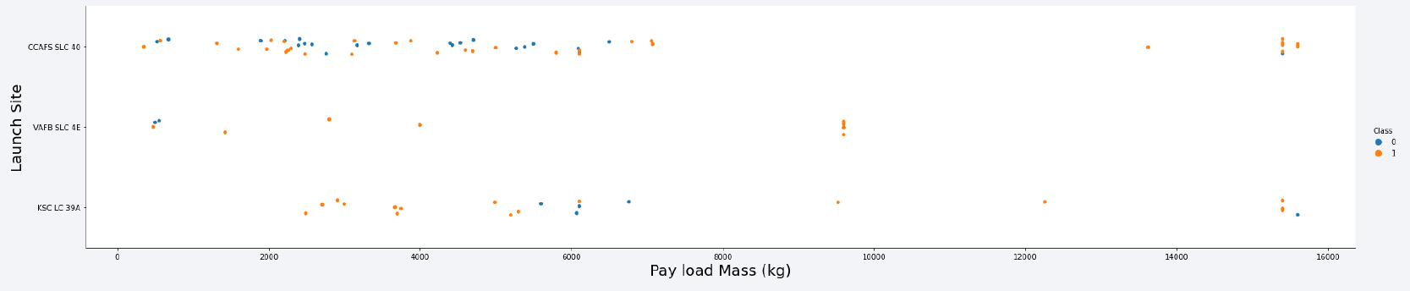
Payload vs. Launch Site
The success rate of a landing can depend on the payload mass. For example, at launch site CCAFS SLC 40, a greater payload mass tends to correlate with a higher success rate. However, if the payload is too heavy, it can lead to a failed landing.

Slide 20
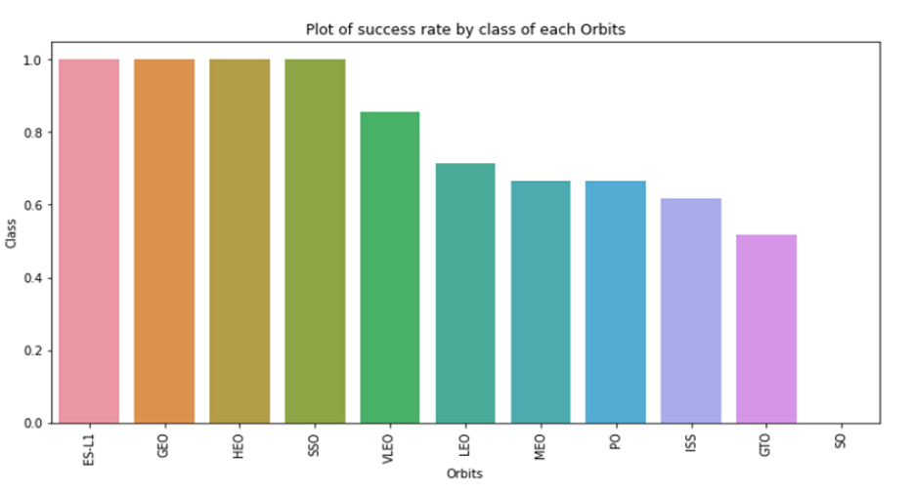
Success Rate vs. Orbit Type
From the plot, we can observe that the orbit types ES L1, GEO, HEO, and SSO have the highest success rates.

Slide 21
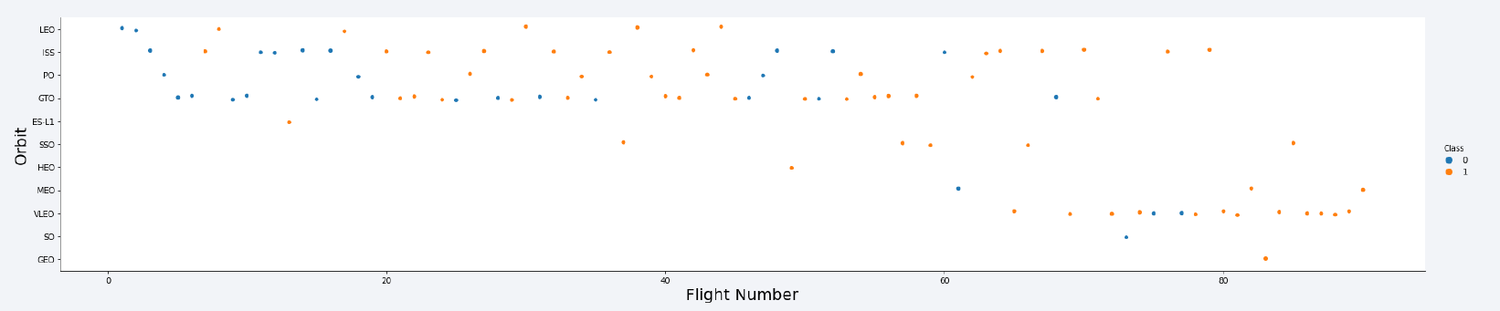
Flight Number vs. Orbit Type
The plot shows the relationship between Flight Number and Orbit Type. We observe that for the LEO orbit, the success rate increases with the number of flights. However, for orbits like GTO, there is no clear relationship between the success rate and the number of flights. It can be inferred that the high success rates of orbits like SSO and HEO may be influenced by the knowledge gained from previous launches in other orbit types.

Slide 22
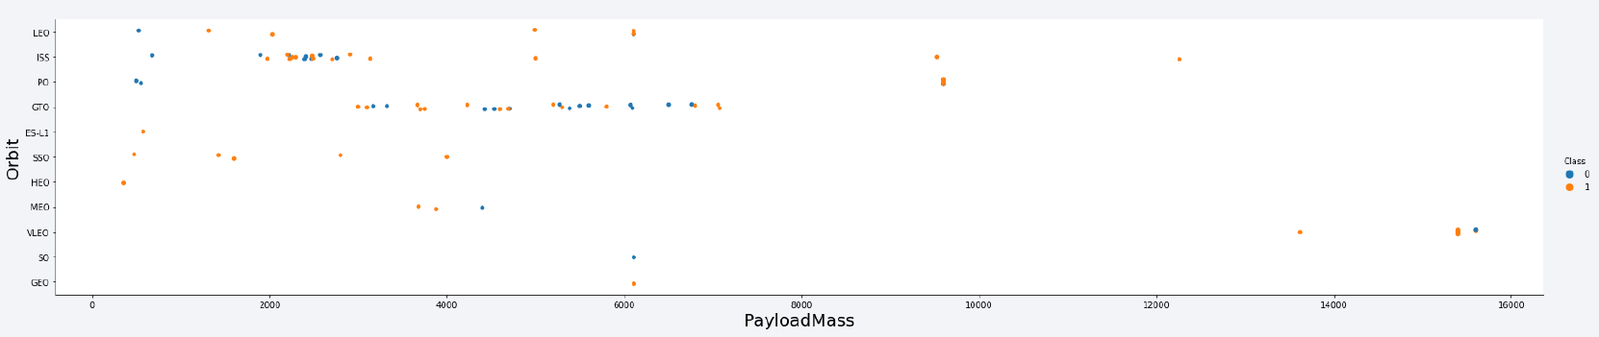
Payload vs. Orbit Type
The payload weight significantly impacts the success rate of launches in certain orbits. Heavier payloads tend to improve the success rate for LEO, PO, and ISS orbits. Conversely, for GTO orbits, reducing the payload weight can enhance the likelihood of a successful launch.

Slide 23
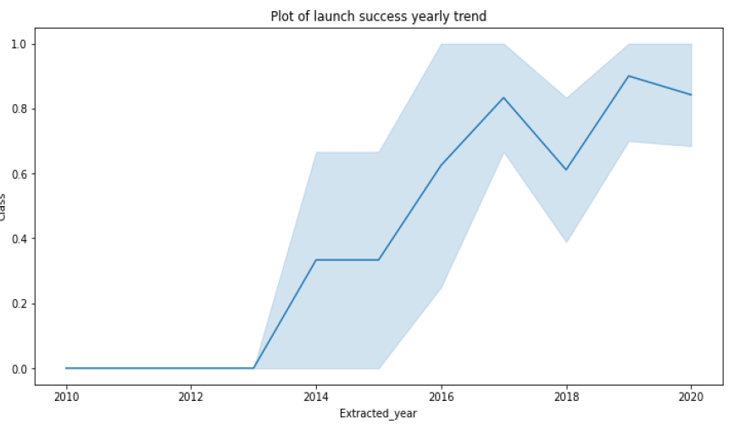
Launch Success Yearly Trend
Since 2013, we have observed a continuous increase in the success rate of SpaceX rocket launches, reaching its peak by 2020.

Slide 24
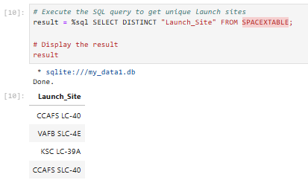
All Launch Site Names
We used the keyword DISTINCT in the query to filter out duplicate launch sites and display only unique ones from the SpaceX data.

Slide 25
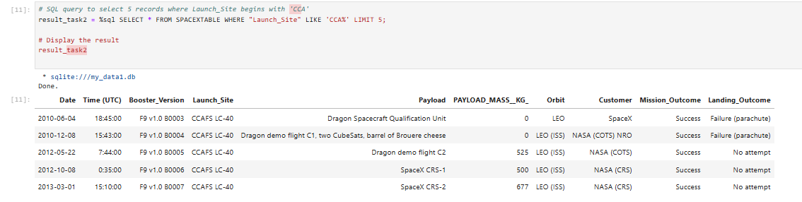
Launch Site Names Begin with 'CCA'
We used the query with a WHERE clause followed by a LIKE clause to filter launch sites containing the substring "CCA." The LIMIT 5 ensures that only 5 records are displayed after the filtering.

Slide 26
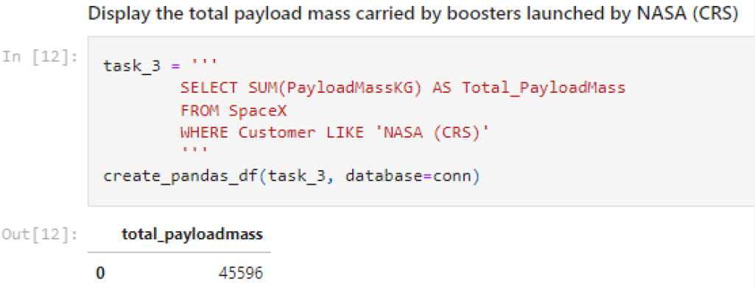
Total Payload Mass
We used the query to calculate the total payload mass carried by boosters for NASA (CRS), which amounted to 45,596.

Slide 27
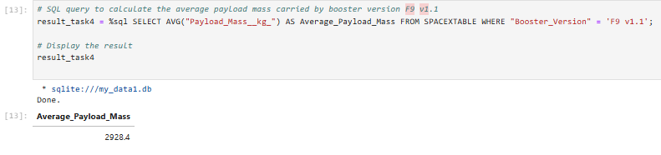
Average Payload Mass by F9 v1.1
We used the query to calculate the average payload mass carried by booster version F9 v1.1, which was 2,928.4.

Slide 28
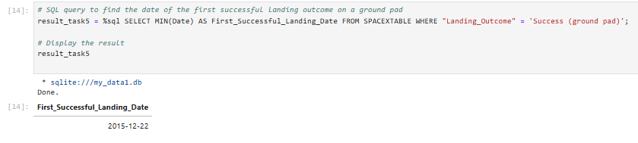
First Successful Ground Landing Date
Using this query, we identified the oldest successful landing, which occurred on December 22, 2015. The WHERE clause filters the dataset to include only successful landings, and the MIN function selects the record with the earliest date.

Slide 29
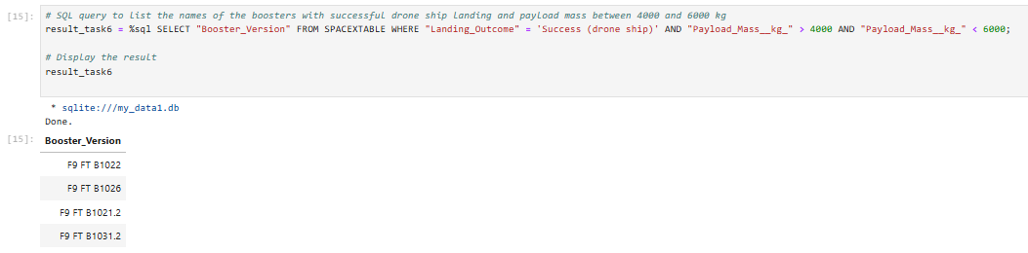
Successful Drone Ship Landing with Payload between 4000 and 6000
We used the WHERE and AND clauses to filter the dataset for boosters that successfully landed on the drone ship, with a payload mass between 4,000 and 6,000 kg.

Slide 30
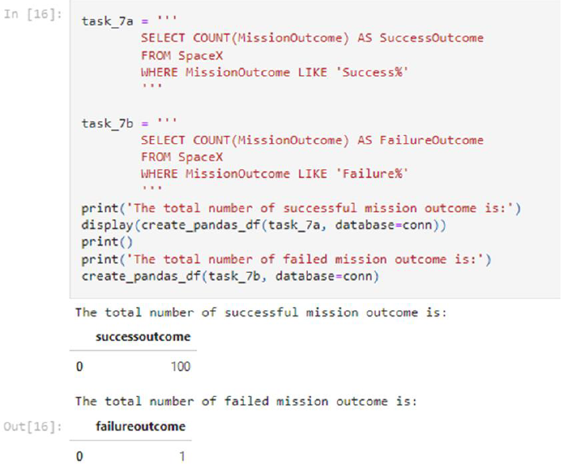
Total Number of Successful and Failure Mission Outcomes
We used the WHERE clause with the LIKE operator and a wildcard ('%') to filter mission outcomes as either a success or failure. The query includes subqueries to count successful and unsuccessful missions, with the COUNT function tallying the filtered records.

Slide 31
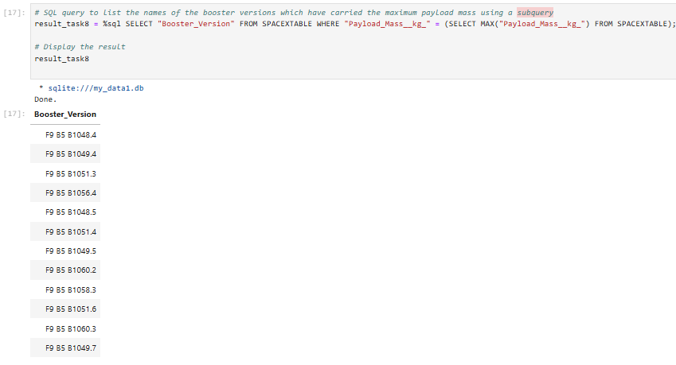
Boosters Carried Maximum Payload
We used a subquery with the SELECT function in the WHERE clause to filter for the booster that carried the heaviest payload. The main query then returns the unique booster version that carried this maximum payload.

Slide 32
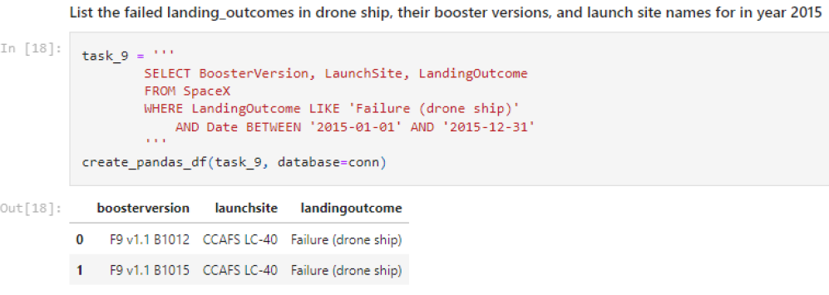
2015 Launch Records
We used a combination of the WHERE, LIKE, AND, and BETWEEN conditions to filter for failed landing outcomes on the drone ship, including booster versions, launch site names, and landing dates from the year 2015.

Slide 33
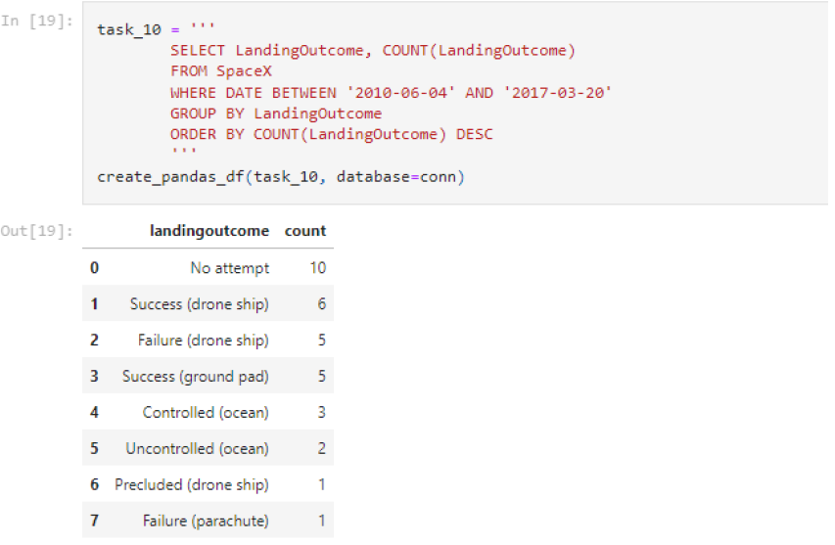
Rank Landing Outcomes Between 2010-06-04 and 2017-03-20
We selected landing outcomes and counted their occurrences from the data, filtering for landing outcomes between 2010-06-04 and 2017-03-20 using the WHERE clause.
We then used the GROUP BY clause to group the landing outcomes and the ORDER BY clause to arrange them in descending order.

Slide 34

Section 3

Slide 35
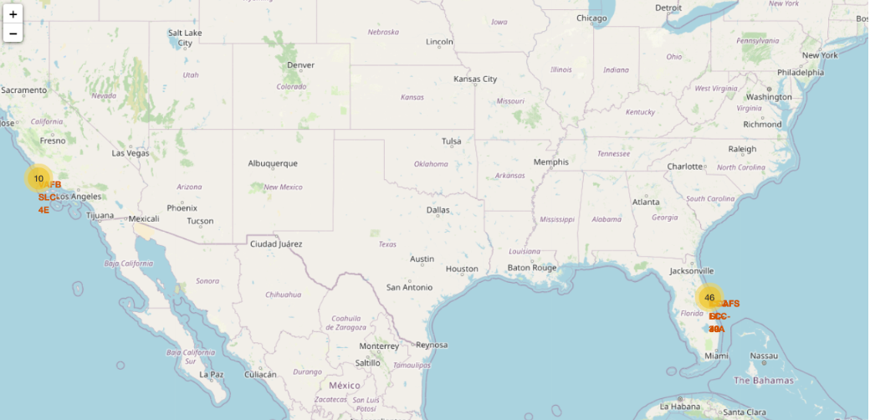
Folium Map – Ground stations
We observe that SpaceX launch sites are situated along the coast of the United States.

Slide 36
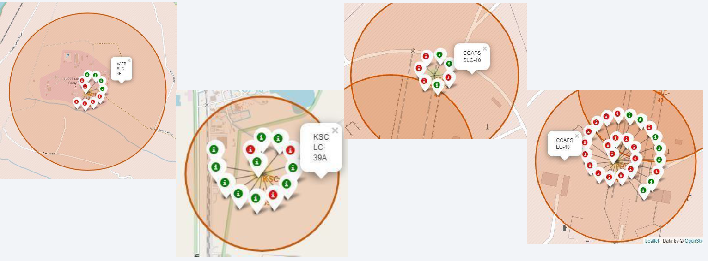
Folium Map – Color Labeled Markers
The green marker indicates successful launches, while the red marker represents unsuccessful launches.

Slide 37
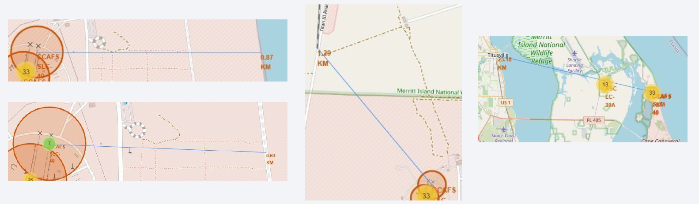
Folium Map – Distances between CCAFS SLC-40 and its proximities
Is CCAFS SLC 40 in close proximity to railways? Yes
Is CCAFS SLC 40 in close proximity to highways? Yes
Is CCAFS SLC 40 in close proximity to coastline? Yes
Do CCAFS SLC 40 keeps certain distance away from cities? No

Slide 38

Section 4

Slide 39
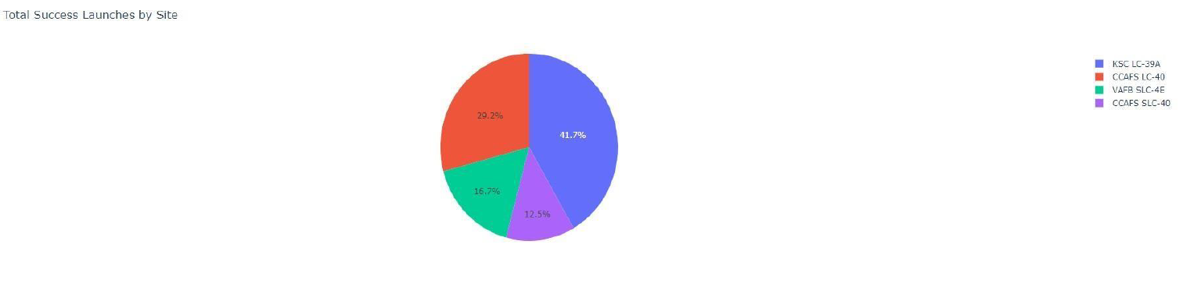
Success Rate of Launches by Site
KSC LC-39A has the best success rate of launches, followed by CCAFS LC-40.

Slide 40
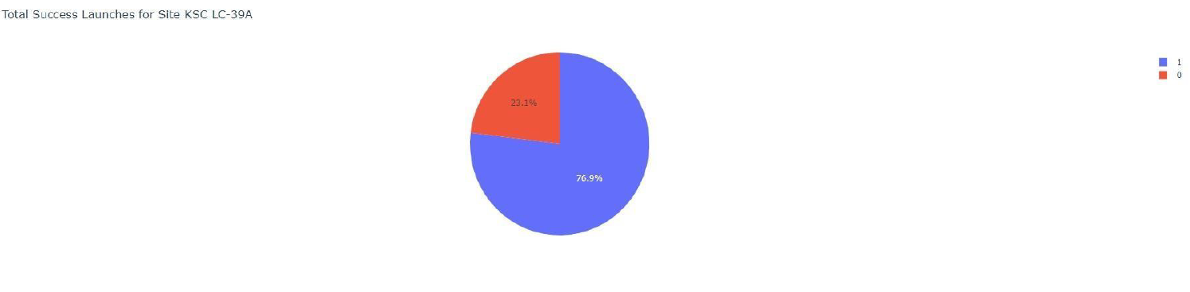
Launch Site with the Highest Launch Success Ratio
We observe that KSC LC 39 A has a success rate of 76.9%, with a failure rate of 23.1%.

Slide 41
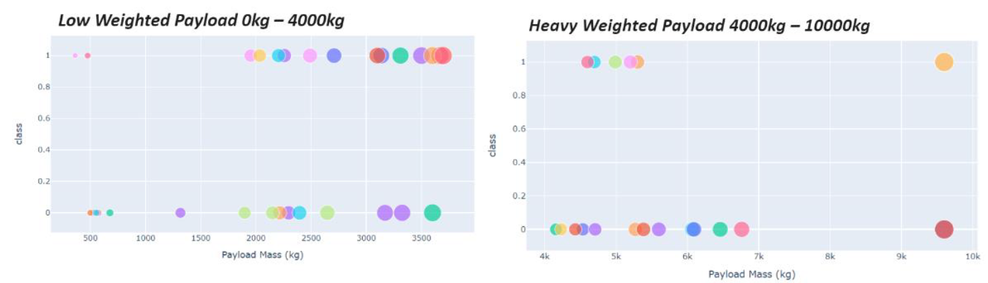
Scatter Plot of Payload vs. Launch Outcome for All Sites, with Payload Range Selected in the Slider
Payloads with lower weights tend to have a higher success rate compared to heavier payloads.

Slide 42

Section 5

Slide 43
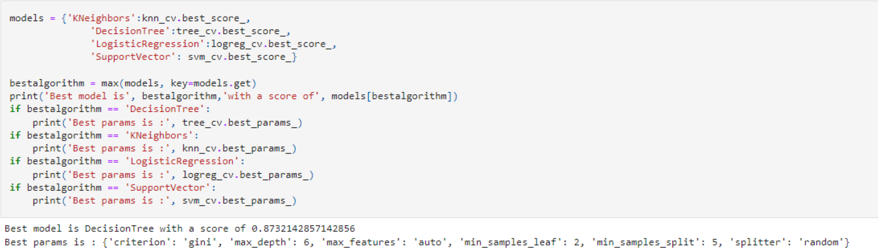
Classification Accuracy
The decision tree classifier is the model with the highest accuracy for classification.

Slide 44
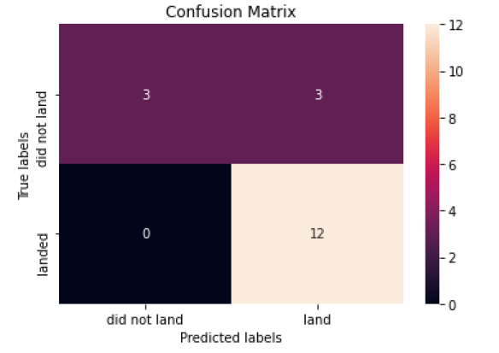
Confusion Matrix
The confusion matrix for the decision tree classifier indicates that the model can differentiate between the various classes. However, a significant issue is the occurrence of false positives, where unsuccessful landings are incorrectly classified as successful.

Slide 45
Conclusions
The success of a mission can be attributed to various factors, including the launch site, the orbit, and notably the number of previous launches, suggesting that knowledge gained between launches contributes to increased success rates. Key observations include:
The orbits with the highest success rates are GEO, HEO, SSO, and ES L1.
Payload mass significantly influences mission success, with lighter payloads generally performing better than heavier ones.
The number of flights at a launch site correlates with a higher success rate, as seen with KSC LC 39A, which has the highest success rate among launch sites.
The overall launch success rate has been increasing since 2013.
The decision tree classifier was selected as the best machine learning model for this task due to its superior training accuracy, even though the test accuracy across all models was similar.
However, the current data does not explain why some launch sites perform better than others. Further investigation with additional data, such as atmospheric conditions, might be required to understand these differences.

Slide 46


